Slide 1


21 DAYS OF
MACHINE LEARNING
6/21
---Code Warriors---

Slide 2

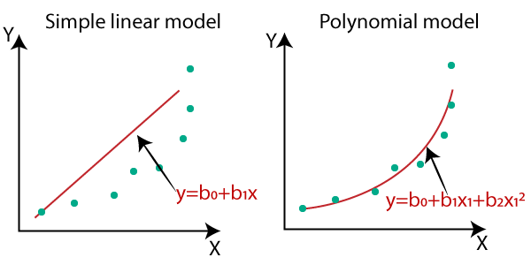
Why polynomial regression
Linear regression requires the relation between the dependent variable and the independent variable to be linear. What if the distribution of the data was more complex as shown in the below figure? Can linear models be used to fit non-linear data? How can we generate a curve that best captures the data as shown below?
---Code Warriors---

Slide 3
What is Polynomial Regression
Polynomial regression is a special case of linear regression where we fit a polynomial equation on the data with a curvilinear relationship between the target variable and the independent variables.
y = m1x1 + m2x1^2 + ... mnx1^n + c
---Code Warriors---

Slide 4
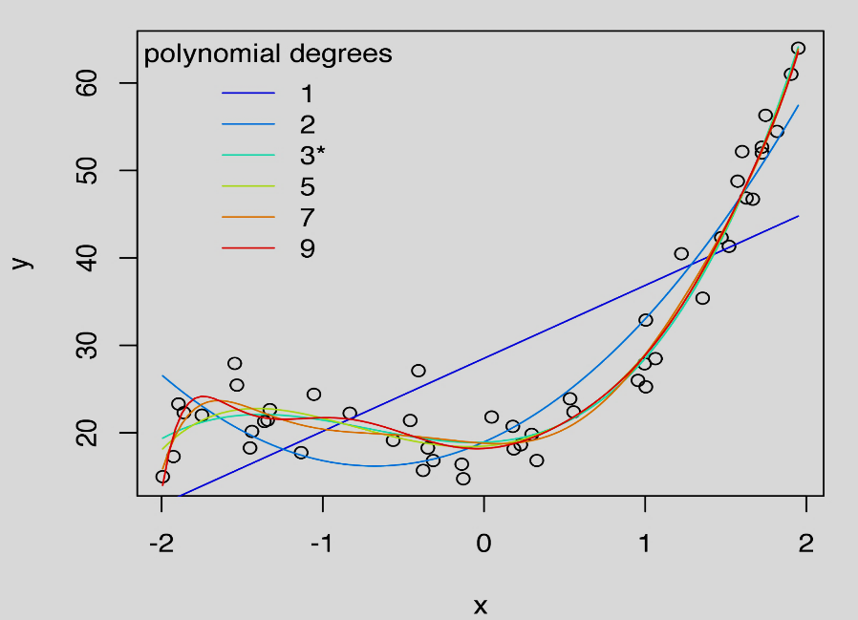
Polynomial Regression
Advantages
Dis-Advantages
The model can fit non linear data better than linear regression
Polynomial basically fits a wide range of curvature.
Too sensitive to the outliers.
As no. of degree increases,chances of overfitting(Memorizing) the data increases
---Code Warriors---

Slide 5
Polynomial Regression Model
1
from sklearn.preprocessing import PolynomialFeatures
2
poly_reg = PolynomialFeatures(degree=n)()
3
X_poly = poly_reg.fit_transform(X)
4
lin_reg=LinearRegression())
lin_reg.fit(X_poly,y)
y_pred=lin_reg.predict(X_test)
5
---Code Warriors---

